Slide 1


SAP UI5 & FIORI with OData TRAINING
Anubhav Oberoy & Shekhar Vedi
Day – 13

Slide 2

Agenda – Day 13
Odata Integration with UI
Understanding the configuration of ui5.yaml
ui5.yaml and ui5-local.yaml for VS Code
Implementing Read in UI
Implementing Create in the UI
Implementing Upadte in UI
Implementing Delete uisng UI
Calling Function Import form the UI
Introduction to GitHub
Creating a Git Repository in GitHub.

Slide 3
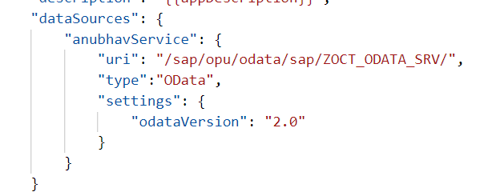
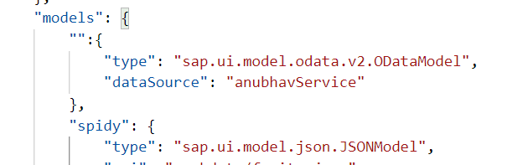
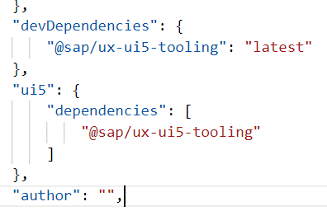
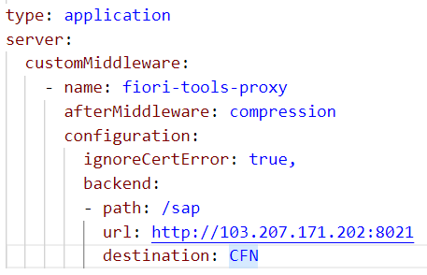
Integration of OData in our Fiori Project
Steps to Integrate our Fiori app with the OData service we have created.
Step 1: Go to manifest.json and define a data source in sap.app section.
Step 2: Go to sap.ui5 section and create a default data model for this data source
TO AVOID CORS issue in BAS tool so we can connect to our SAP SERVER
Step 3: Add a dev-dependency in package.json file to latest UI5 tooling - @sap/ux-ui5-tooling
Step 4: Also add a section called UI5 in package.json to use the tooling for the project.
Step 5: We will cheat the browser by adding a proxy module, this proxy module will re-direct all the calls starring /sap top our SAP Server via destination. In ui5.yaml file provide middleware configuration
Step 6: Test app using ui5 serve or fiori run command
Step 7: Binding with ODATA entityset

Slide 4
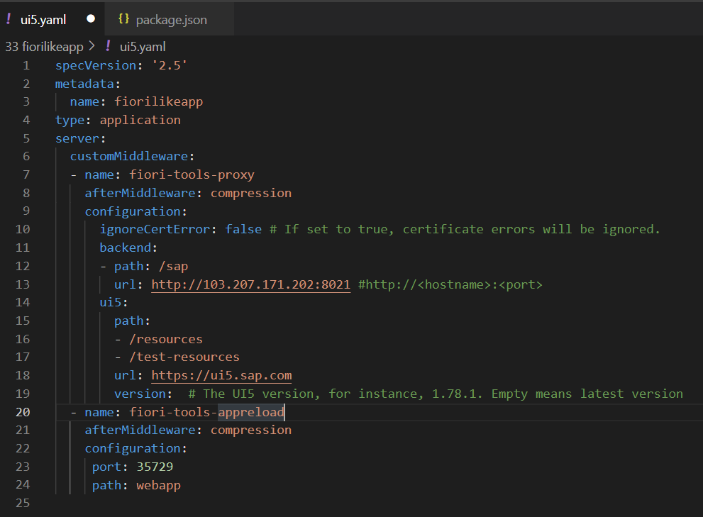
Configuring ui5.yaml for VS Code
To use the OData service in VS Code we must configure the ui5.yaml file according to that. We need to configure it according to the below format.
specVersion: '2.5'
metadata:
name: fiorilikeapp
type: application
server:
customMiddleware:
- name: fiori-tools-proxy
afterMiddleware: compression
configuration:
ignoreCertError: false
backend:
- path: /sap
url: http://<hostname>:<port>
ui5:
path:
- /resources
- /test-resources
url: https://ui5.sap.com
version:
- name: fiori-tools-appreload
afterMiddleware: compression
configuration:
port: 35729
path: webapp

Slide 5
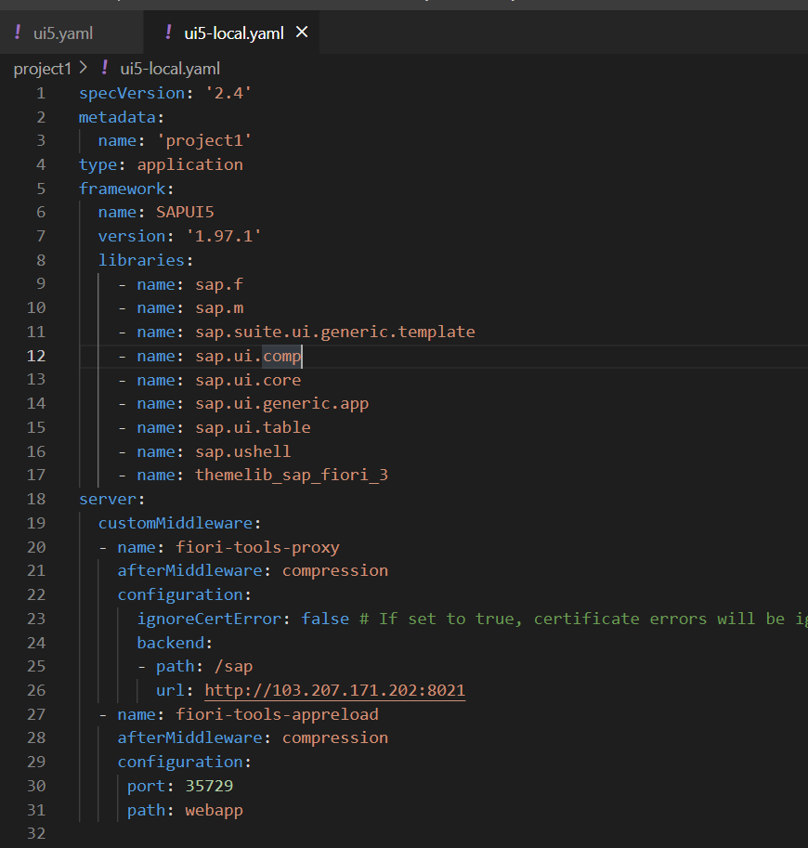
ui5-local.yaml configuration
To run and access the OData service in application in a local environment we also need a ui5-local.yaml file. The structure of ui5-local.yaml file is shown below:
specVersion: '2.4'
metadata:
name: 'project1'
type: application
framework:
name: SAPUI5
version: '1.97.1'
libraries:
- name: sap.f
- name: sap.m
- name: sap.suite.ui.generic.template
- name: sap.ui.comp
- name: sap.ui.core
- name: sap.ui.generic.app
- name: sap.ui.table
- name: sap.ushell
- name: themelib_sap_fiori_3
server:
customMiddleware:
- name: fiori-tools-proxy
afterMiddleware: compression
configuration:
ignoreCertError: false # If set to true, certificate errors will be ignored. E.g. self-signed certificates will be accepted
backend:
- path: /sap
url: http://103.207.171.202:8021
- name: fiori-tools-appreload
afterMiddleware: compression
configuration:
port: 35729
path: webapp

Slide 6

Exercise
In this exercise we will add the configuration to Integrate the OData with our existing app.
And we will bind the View1 with the OData model.
Along with that we will also see how to read the data of a single product.
To do that when we select a product form the product list then the details of that product will be loaded on the View2.
Exercise part 1 code/resource: Configuring the app to access OData and loading the list of products on view1
manifest.json
ui5.yaml
package.json
View1.view.xml
ui5.yaml and ui5-local.yaml config for VS Code
ui5.yaml
ui5-local.yaml
Exercise part 2 code/resource: Getting the data of single product with association To_Supplier on View2.
View1.view.xml
View1.controller.js
View2.view.xml
View2.controller.js
MoreInfo.fragment.xml

Slide 7
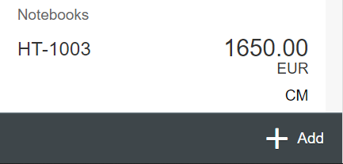
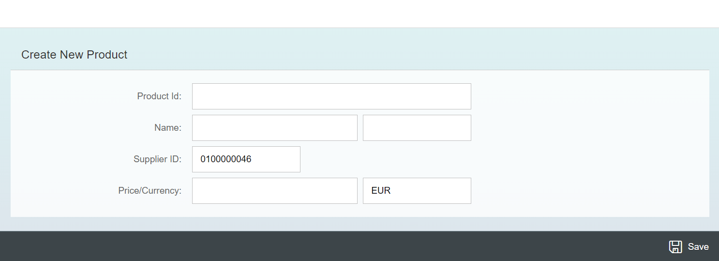
Exercise - Implement Create using UI
Now we will implement create operation in the UI. To do that we need to add a new screen in our application. In that screen we will add a simple form to fill the details of the product and a Save button in the footer of that page.
For this have to a new Add button in the footer of the View1 and on press of that button we will navigate to the new Add View.
Exercise code/resource:
View1.view.xml
View1.controller.js
Add.view.xml
Add.controller.js
manifest.json

Slide 8

Exercise – Implementing Update and Delete
Now we want to Update and Delete the selected record form the backend. To do that we will load the data of the record. Once the data is loaded to update and delete the data, we will add two buttons in the footer of the view named as Save and Delete. We will also add a clear button to clear the data of form.
On entering the Product ID of the product in the Input field and press enter we will load the data of that product in the Form.
Exercise code/resource:
Add.view.xml
Add.controller.js

Slide 9
Exercise – Using Function Import from UI
Now we want to Call the function import form the UI. To do that we will add a button near the Product Id input field. On press of that button, we will load the most expensive product in the form.
Exercise code/resource:
Add.view.xml
Add.controller.js

Slide 10

Introduction to Git and GitHub
Git is a version control system that lets you manage and keep track of your source code history.
GitHub is a cloud-based hosting service that lets you manage Git repositories.
Git HUB is a central repository to store all the code. Git is a distributed repository management system, which allows development teams to organize and sync their development code.
Use Case- I am working as a Fiori Developer in an MNC and I want to share my code with fellow developers, currently I am downloading the zip/tar file and sharing over email.
This way we will have piles of emails in our account,
especially when we work in a team of size 40 developers it becomes very hard to sync changes.
There is version control. Last night my app was stable, I made some changes this morning which messed up the whole project. I some how pray to god that can you please take me in past.
In a big team, many developers touching each other’s code and it’s hard to blame someone who disrupt the code.
It is also very hard to merge changes when done in same file.
As a developer, I am using BAS today, tomorrow I will use VS Code and next day Web IDE and very next week Atom. How can I easily port my code between these tools.
You can install git in local machine using below link (however, it comes along with all dev tools)
https://git-scm.com/downloads

Slide 11


How GitHub Works and commands in Git
We will see some important commands related to Git and will see how GitHub works.
Some important commands to use git.
git Init: It is used to initialize a new Git Repository in the system.
git add <filename>: It is used to stage the changes of the file to git repository. We can use ‘git add .’ to stage the changes of all files.
git commit: It is used to commit all the staged changes with a message.
git reset hard: Discard all the staged changes and discard the changes in all the files.
git push: It is used to push all the changes in the git repository.
git pull: It is used to pull the new changes made by other users in the project.
git status: It is used to check the status
git clone: It is used to clone a repository.
git remote add <repo URL>: Add a local repository to a remote repository.
Fiori Project (or any kind of project)
User (Anubhav)
But how all users will work on the project at a same time?
Anubhav’s local machine
Here GitHub comes into picture
Users which are working on the different parts of the same project on different Platforms (BAS, VS Code, Web IDE)
Project Repository
The project will be kept in a repository in the GitHub

Slide 12
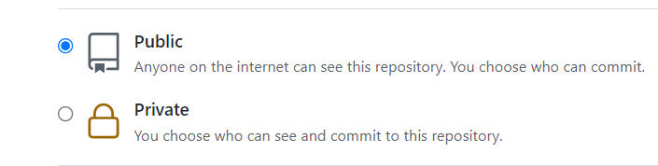
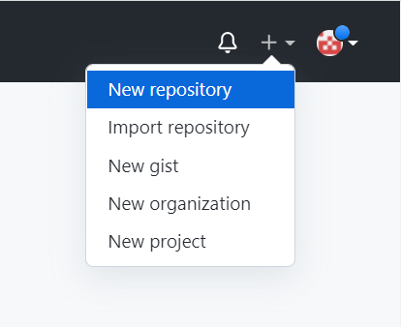
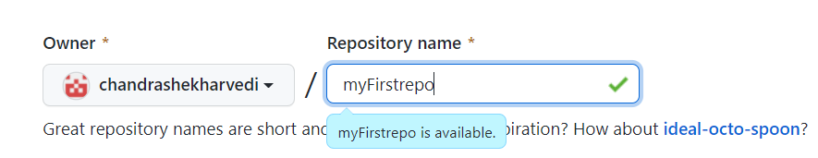
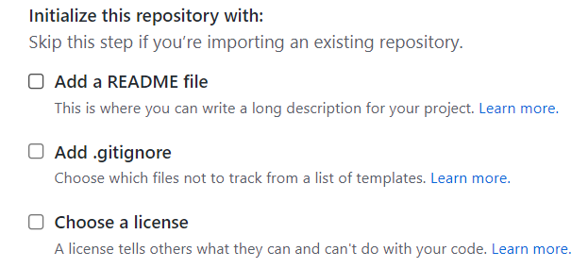
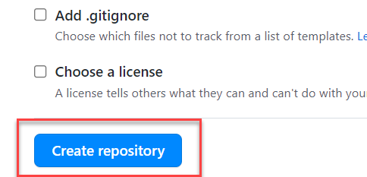
Steps to Create a new git Repository
Step by Step process to create a git repository in GitHub. First of all you must have a GitHub account, if not then go to this link https://github.com/signup?source=login and create a new Account.
Step 1: Click on the plus button in the top right corner of the screen and select ‘New Repository’.
Step 2: Type a short, memorable name for your repository. And give a description (optional).
Step 3: Select the type of repository. Public or Private
Step 4: Set how you want to Initialize the repository.
Step 5: Click on Create Repository. Your Repository will be created.
Repository Created Successfully

Slide 13
Title
Content

Slide 14

End of Day 13

Slide 15

Questions

Slide 16

Anubhav Oberoy

Slide 17


We’re committed to empower you to be
Most Desirable Resource
through powerful training solutions.
We build the workforce of the future.
250+
Corporate Clients
30,000+
Learners Trained
25000+
Learners Placed
FREE WEBINARS
Sign up for free webinars with industry experts every fortnight!
Enroll Now!
Contact us today!
https://anubhavtrainings.com/

Slide 18




More from AnubhavTrainings.com

Slide 19
Title
Content

